Slide 1

Department of Computer Science and Engineering
MULTIMODAL CYBERBULLYING DETECTION USING INTER-MODAL-ATTENTION-BASED DEEP LEARNING
PRESENTED BY
Tatapudi Rajesh (22471A05O5)
Panchumarthi Lakshmi Gopinath (22471A05N7)
Chilaka Santhosh (23475A0511)
Under the Guidance of,
Mothe Suneetha M. Tech,
Assistant Professor,
Department of Computer Science and Engineering,
Narasaraopeta Engineering College (Autonomous), Narasaraopet- 522 601.
Final_PPT
Department of CSE

Slide 2
OUTLINE
Abstract
Introduction
Literature Survey
Research Gaps
Problem Statement
Objectives
Block Diagram / Flow Diagram
Methodology
Implementation
Results and Analysis
Conclusion & Future Scope
References
Acknowledgements
Question and Answers
Final_PPT
Department of CSE

Slide 3
ABSTRACT
Cyberbullying on social media continues to affect users emotionally and socially, creating an urgent need for automated detection systems that can interpret both language and visuals.
In this, designed a multimodal framework that learns from text and image data using an inter-modal attention mechanism. The text is represented through BERT embeddings, while BLIP is applied to generate image captions and visual context. These representations are then fused and processed through BiLSTM layers to recognize bullying cues. Along with classification, the system performs input validation, NSFW screening, and assigns severity and category levels to each post. Experiments conducted on the MMHS150K dataset show an accuracy of 87.2\%, precision of 85.6\%, recall of 84.9\%, and an F1-score of 85.2\%, surpassing prior methods such as SAFE, MCNN, and LBP-sim.The framework is lightweight, interpretable, and adaptable for real-time content moderation across social media platforms.
Final_PPT
Department of CSE

Slide 4
INTRODUCTION
Context of Social Media
Social media enables instant communication and content sharing across the world.
User's express opinions through text, images, memes, and comments on digital platforms.
This openness has created new challenges in controlling harmful online behavior.
Impact of Missuse
Misuse of social platforms leads to harassment, humiliation, and mental stress.
Victims often face anxiety, depression, and social isolation due to online abuse.
Manual moderation is not sufficient because of the huge volume of daily posts.
Limitations of Text-Only Sysytems
Traditional systems analyze only written content and ignore images.
They fail to understand memes, sarcasm, and mixed-language expressions.
A multimodal approach is required to capture the real intent behind posts.
Final_PPT
Department of CSE

Slide 5
NEED FOR MULTIMODAL APPROACH
Structure of Real Social Media Content
Posts are composed of captions, emojis, images, and comments.
User's express emotions through a combination of visual and textual cues.
Bullying intent is often hidden in this mixed representation.
Relationship Between Modalities
The meaning of a post depends on how text relates to the image.
A neutral sentence can become abusive when paired with an offensive meme.
Interpreting both modalities together provides true contextual meaning.
Requirement of Multimodal Intelligence
Effective detection must analyze visual and linguistic signals jointly.
The model should understand sarcasm, symbolism, and implicit threats.
This motivates a unified deep learning framework using text and image.
Final_PPT
Department of CSE

Slide 6
EXISTING SOLUTIONS
Traditional Detection Methods
Early systems relied on keyword filtering and rule-based approaches.
Machine learning models such as Naïve Bayes and SVM were used for classification.
These methods depended heavily on manually designed features.
Deep Learning Based Approaches
Recent works introduced neural networks and transformer models.
BERT and LSTM-based models improved contextual understanding of language.
Some frameworks attempted to combine metadata with textual features.
Current Multimodal Efforts
Few studies explored joint analysis of text and images.
Existing models used CNN features or OCR for visual understanding.
Most approaches suffered from high computation and weak alignment between modalities.
Final_PPT
Department of CSE

Slide 7
PROPOSED IDEA
Core Concept of the Project
The proposed system detects cyberbullying using both text and image information.
It combines advanced language and vision models in a single framework.
An inter-modal attention mechanism learns the relationship between modalities.
Technologies Used
BERT is used to extract contextual textual embeddings from posts.
BLIP model generates meaningful image descriptions and visual features.
A BiLSTM network models sequential dependencies after feature fusion.
Expected Output
The system classifies whether a post is bullying or not.
It provides confidence score, severity level, and bullying category.
The output can be directly used for social media moderation systems.
Final_PPT
Department of CSE

Slide 8
LITERATURE SURVEY
No | Title | Author | Journal Name & Year | Methodology Adapted | Key Findings | Gaps
1 | An inter-modal attention-based deep learning framework using unified modality for multimodal fake news, hate speech, and offensive language detection | Ayetiran & Ozgobek, 2024, Elsevier | https://www.sciencedirect.com/science/article/pii/S0306437924000378 | BiLSTM-CNN + Inter-modal Attention (model architecture/components) | They achieved state-of-the-art results by combining image and text, creating a truly unified representation. | There is no much explainability, only a "yes/no" answer for classification, and it demands a lot of computing power.
2 | Cyberbullying Detection Based on Emotion | Al-Hashedi et al., 2023, IEEE | https://ieeexplore.ieee.org/document/10138186 | BERT, XLNet (as core models) + emotion classifier (specific model/component) | They got 97% F1 score for emotions, 92% for bullying texts. | It only works for one language, and getting humans to label all that data is super expensive.
3 | Ensemble Learning With Tournament Selected Glowworm Swarm Optimization Algorithm for Cyberbullying Detection on Social Media | Ravuri Daniel et al., 2023, IEEE | https://ieeexplore.ieee.org/document/10292654 | GloVe (as an embedding technique/feature representation) + ELSTM-AB (model) | They got 96.4% accuracy and making predictions in just 0.32 seconds. | Can't handle pictures or videos and hasn't been tested in real-time situations yet.
4 | Toward Multi-Modal Approach for Identification and Detection of Cyberbullying in Social Networks | Al-Khasawneh et al., 2024, IEEE | https://ieeexplore.ieee.org/document/10574823 | BiLSTM + Hierarchical Attention, MLP for fusion (all are model components/architectures) | 92.1% accuracy for Twitter and 86.4% F1 for Instagram. | No tests on image or video content. Plus, you'll need a powerful GPU.
5 | Multilingual Detection of Cyberbullying in Mixed Urdu, Roman Urdu, and English Social Media Conversations | Razi & Ejaz, 2024, IEEE | https://ieeexplore.ieee.org/document/10608139 | mBERT/MuRIL (as core models) + weighted harm scoring (specific logic/algorithm) | They got 92% F1-score and, big news, created the first cyberbullying dataset that works in three languages. | No images or videos, and it only tells you "yes" or "no" for bullying (binary classification).
Final_PPT
Department of CSE

Slide 9
LITERATURE SURVEY
No | Title | Author | Journal Name & Year | Methodology Adapted | Key Findings | Gaps
6 | A Chained Deep Learning Model for Fine-Grained Cyberbullying Detection With Bystander Dynamics | Alfurayj et al., 2024, IEEE | https://ieeexplore.ieee.org/document/10614592 | BERT + LSTM (chained), AdamW optimizer (optimizer, not a model) | They got 89% F1-score | The dataset was small (just 639 tweets), and because they chained models, errors might have piled up. No multimodal input here either.
7 | RoBERTaNET: Enhanced RoBERTa Transformer Based Model for Cyberbullying Detection With GloVe Features | Arwa A. Jamjoom et al., 2024, IEEE | https://ieeexplore.ieee.org/document/10495045 | RoBERTa (as core model) + GloVe (embedding/feature) | This one is 95% accuracy and 96% F1 in cross, coming out on top in their 5-fold tests. | There is a thought that GloVe might not be adding much if you're already using RoBERTa. Also, it was only tested on Twitter data and didn't clearly fix the class imbalance problem.
8 | From Text to Insight: An Integrated CNN-BiLSTM-GRU Model for Arabic Cyberbullying Detection | Eman-Yaser Daraghmi et al., 2024, IEEE | https://ieeexplore.ieee.org/document/10605813 | Hybrid CNN-BiLSTM-GRU (model architecture), Adam, SGD, RMSProp (optimizers) | Arabic text: 98.8% accuracy and a 99.5% recall. | But it's exclusively for Arabic, the model is so complex, and they didn't test it on live or real-time data.
9 | Cyberbullying Detection and Abuser Profile Identification on Social Media for Roman Urdu | Ayesha Atif et al., 2024 | https://ieeexplore.ieee.org/document/10638042 | GRU (model), Compared to SVM, RF (other models) | Achieved 97% accuracy and F1, validated thoroughly with 10-fold cross-validation. | It's limited to Roman Urdu, might have cultural and regional biases, and can't handle emojis or slang.
10 | Social Media Forensics: An Adaptive Cyberbullying-Related Hate Speech Detection Approach Based on Neural Networks With Uncertainty | Yasmine M. Ibrahim et al., 2024 | https://ieeexplore.ieee.org/document/10614592 | MLP (model) + Neurosophic Logic (framework/logic), OvO strategy (multi-class handling strategy for models) | This one got 95–97% accuracy and even beat out traditional machine learning models. | The "old-school" TF-IDF might not capture deep meaning, they didn't use modern contextual embeddings, and the tuning process was quite complicated.
Final_PPT
Department of CSE

Slide 10
RESEARCH GAPS
Key Limitations in Existing Systems
Limited Explainability
Most models provide only a binary decision without reasons.
High Computational Cost Many approaches depend on OCR and heavy CNN pipelines.
Lack of True Multimodal Fusion Text and image are processed separately with weak interaction.
No Real-Time Readiness Systems are not optimized for live social media streams.
Restricted Output Do not provide severity level or category of bullying.
Final_PPT
Department of CSE

Slide 11
PROBLEM STATEMENT
Main Issue
Cyberbullying on social media platforms has become a growing threat, negatively impacting users’ mental health and online safety.
Existing Limitations
Current detection systems mainly rely on textual data, lack explainability, and fail to process multimodal content like images.
Core Problem
There is no unified and efficient framework that can accurately detect, explainability and interpret cyberbullying from both text and visual data in real time.
Goal
To develop a multimodal deep learning model that integrates text and image features using inter-modal attention, enabling accurate, explainable, and real-time cyberbullying detection.
Final_PPT
Department of CSE

Slide 12
OBJECTIVES
To develop an Inter-modal-attention-based Deep Learning for accurate and efficient Cyberbullying detection.
Specific Objectives
To develop a multimodal deep learning framework that effectively combines textual and visual features for cyberbullying detection.
To implement an inter-modal attention mechanism that enhances the interaction between text and image modalities for better contextual understanding.
To improve the accuracy and robustness of detection compared to existing single-modality or traditional models.
To ensure scalability and efficiency by optimizing the model for real-time prediction on social media data.
To provide interpretable outputs that help moderators understand why a post is flagged as cyberbullying.
Final_PPT
Department of CSE

Slide 13
DATASET OVERVIEW (MMHS150K)
Large-scale multimodal cyberbullying dataset.
Contains text captions + images from social media.
Total samples: 150,000
Data Split
Training: 134,823
Validation: 5,000
Testing: 10,000
Class Distribution
Hate/Bullying: 44,001
Not-Hate: 105,999
Final_PPT
Department of CSE

Slide 14
PREPROCESSING: TEXT
Removal of noise such as:
Emojis
URLs
Hashtags
user mentions
special characters
Convert all text to lowercase for uniformity
Tokenization using BERT tokenizer
Padding or truncation to 128 tokens
Generation of attention mask for batch processing
Constructed a unified text field by combining the original tweet, image caption (Prompt A), and alternative caption (Prompt B).
Before Preprocessing (Raw) | After Preprocessing (Unified Text)
"@puuscfeiin this nigga said i’m... in atlanta🤣🤣 check this link http://t.co/xyz #LOL" | "this nigga said i’m... in atlanta [CAPTION] A man smiling in Atlanta [ALT] A person in a city background"
Example:
Original Tweet + [CAPTION] Caption A + [ALT] Caption B
Final_PPT
Department of CSE

Slide 15
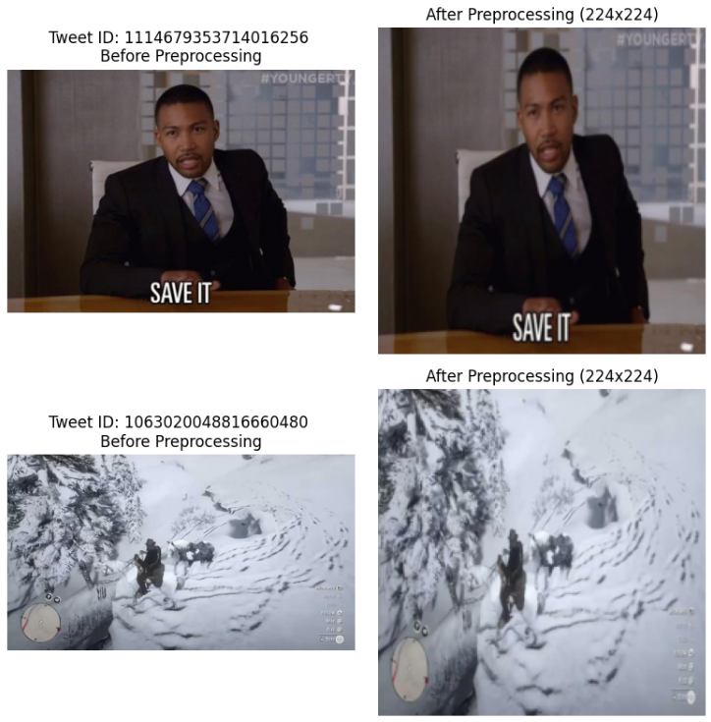
PREPROCESSING: IMAGE
Resize all images to 224 × 224 pixels
Convert images to RGB format
Normalize using ImageNet mean and standard deviation
BLIP model generates contextual image captions
Visual features projected into text feature space
Before Preprocessing | After Preprocessing
Images had varying resolutions (from small thumbnails to large images). Some images were noisy, blurred, or contained unnecessary background. Raw image bytes were inconsistent in format (PNG, JPEG, etc.). | All images were standardized to 224×224 resolution. Converted to RGB format for consistency. Normalized using ImageNet statistics (mean=[0.485, 0.456, 0.406], std=[0.229, 0.224, 0.225]). Augmentations such as random flipping, cropping, and rotations were applied during training to improve generalization.
Final_PPT
Department of CSE

Slide 16
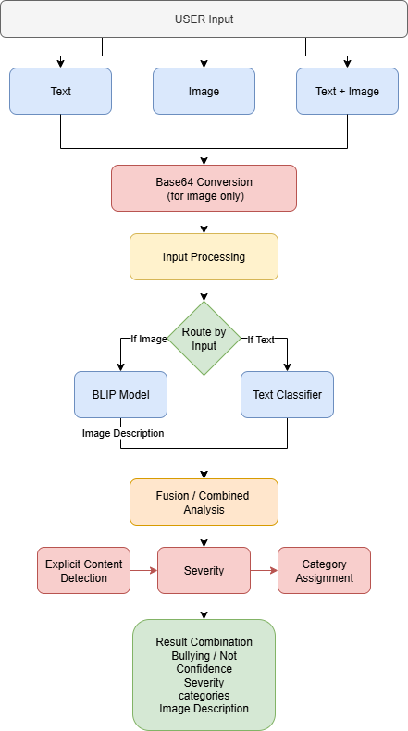
ARCHITECTURE
Workflow Overview:
Accepts text, image, or text + image input
Converts image to Base64 format
Performs input preprocessing
Routes input to BLIP (image) or Text Classifier
Extracts image captions and text embeddings
Combines features via inter-modal attention + BiLSTM
Performs content detection, severity, and category assignment
Outputs final bullying / non-bullying result with confidence score
Architecture Highlights:
Uses BERT for text and BLIP for images
Outputs bullying label, confidence, and severity
Lightweight and real-time adaptable
Final_PPT
Department of CSE

Slide 17
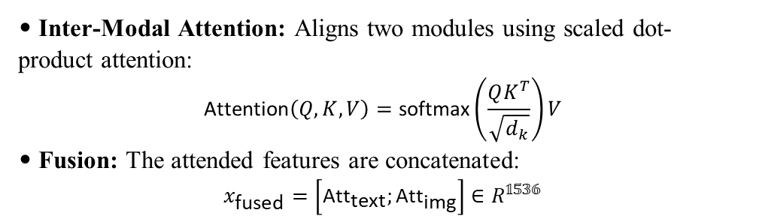
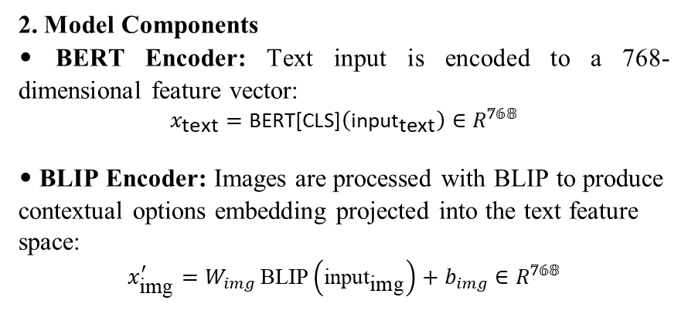
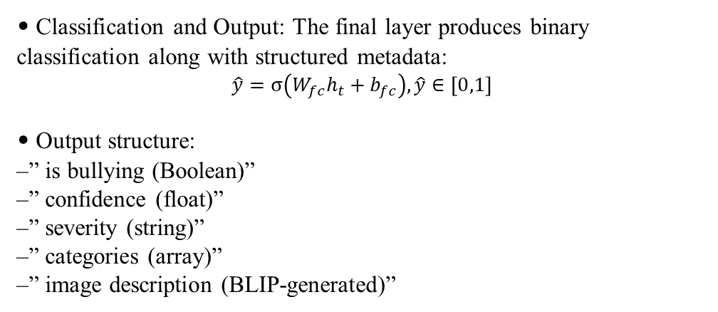
METHODOLOGY
Methods and Approaches (BERT + BLIP)
1. Preprocessing
Remove emojis, URLs, hashtags, mentions, and punctuation. Convert all text to lowercase.
Tokenize using the BERT tokenizer and truncate to 128 tokens.
Resize every images to 224 * 224 pixels.
• Inter-Modal Attention: Aligns two modules using scaled dot-product attention:
$$\text{Attention}\left(Q,K,V\right)=\text{softmax}\left(\frac{QK^{T}}{\sqrt{d_{k}}}\right)V$$
• Fusion: The attended features are concatenated:
$$x_{\text{fused}}=\left[{\text{Att}}_{\text{text}};{\text{Att}}_{\text{img}}\right]∈R^{𝟙𝟝𝟛𝟞}$$
2. Model Components
• BERT Encoder: Text input is encoded to a 768-dimensional feature vector:
$$x_{\text{text}}=\text{BERT}\text{[}\text{CLS}\text{]}\left({\text{input}}_{\text{text}}\right)∈R^{𝟟𝟞𝟠}$$
• BLIP Encoder: Images are processed with BLIP to produce contextual options embedding projected into the text feature space:
$$x_{\text{img}}^{′}=W_{img} \text{BLIP}\left({\text{input}}_{\text{img}}\right)+b_{img}∈R^{𝟟𝟞𝟠}$$
• Classification and Output: The final layer produces binary classification along with structured metadata:
$$\hat{y}=σ\left(W_{fc}h_{t}+b_{fc}\right),\hat{y}∈\left[0,1\right]$$
• Output structure:
–” is bullying (Boolean)”
–” confidence (float)”
–” severity (string)”
–” categories (array)”
–” image description (BLIP-generated)”
‘R’ just means the vector is made up of normal real numbers, representing the numeric features used by the model.
Final_PPT
Department of CSE

Slide 18
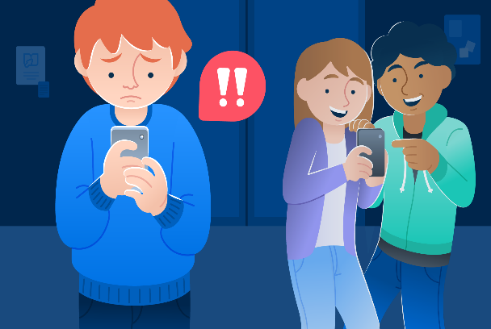
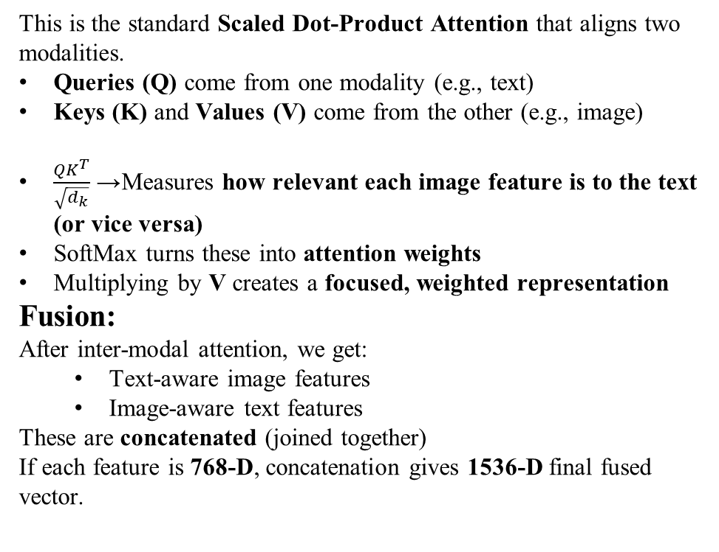
METHODOLOGY
Inter-Modal Attention Fusion Mechanism
This is the standard Scaled Dot-Product Attention that aligns two modalities.
Queries (Q) come from one modality (e.g., text)
Keys (K) and Values (V) come from the other (e.g., image)
$\frac{QK^{T}}{\sqrt{d_{k}}}$→ Measures how relevant each image feature is to the text (or vice versa)
SoftMax turns these into attention weights
Multiplying by V creates a focused, weighted representation
Fusion:
After inter-modal attention, we get:
Text-aware image features
Image-aware text features
These are concatenated (joined together)
If each feature is 768-D, concatenation gives 1536-D final fused vector.
Text Provided by User
“This loser should stop posting selfies.
Nobody wants to see your stupid face.”
Image Provided by User
(Example shown above — assume it is
a picture of a person posting a selfie.)
Now the model (Inter-Modal Attention) tries to understand:
“How does the text relate to the image?”
Example Interpretation
The text insults someone taking a selfie
Image shows a person taking a selfie
High alignment → HIGH bullying probability
Attention checks:
Does the word “loser” relate to the person in image? → Yes
Does “stupid face” refer to the face in the photo? → Yes
The model strengthens this relationship using attention weights.
Final_PPT
Department of CSE

Slide 19
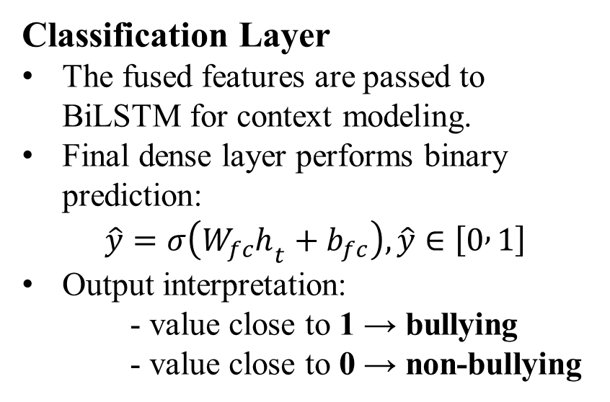
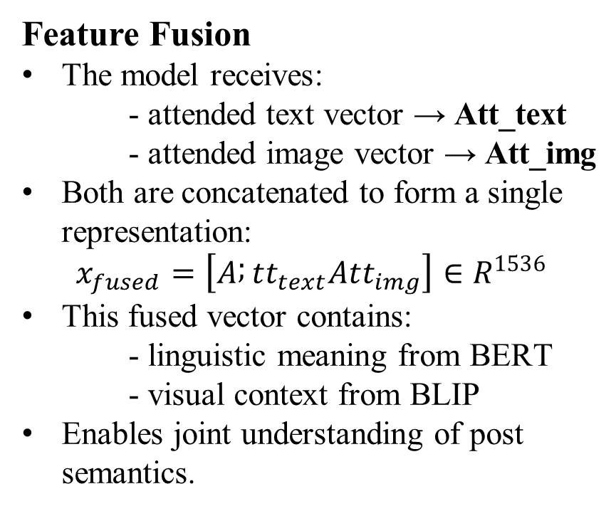
FUSION & CLASSIFICATION
Feature Fusion
The model receives:
- attended text vector → Att_text
- attended image vector → Att_img
Both are concatenated to form a single representation:
$$x_{fused}=\left[A ; tt_{text}Att_{img}\right]∈R^{1536}$$
This fused vector contains:
- linguistic meaning from BERT
- visual context from BLIP
Enables joint understanding of post semantics.
Classification Layer
The fused features are passed to BiLSTM for context modeling.
Final dense layer performs binary prediction:
$$\hat{y}=σ\left(W_{fc}h_{t}+b_{fc}\right), \hat{y}∈\left[0 , 1\right]$$
Output interpretation:
- value close to 1 → bullying
- value close to 0 → non-bullying
Final_PPT
Department of CSE

Slide 20
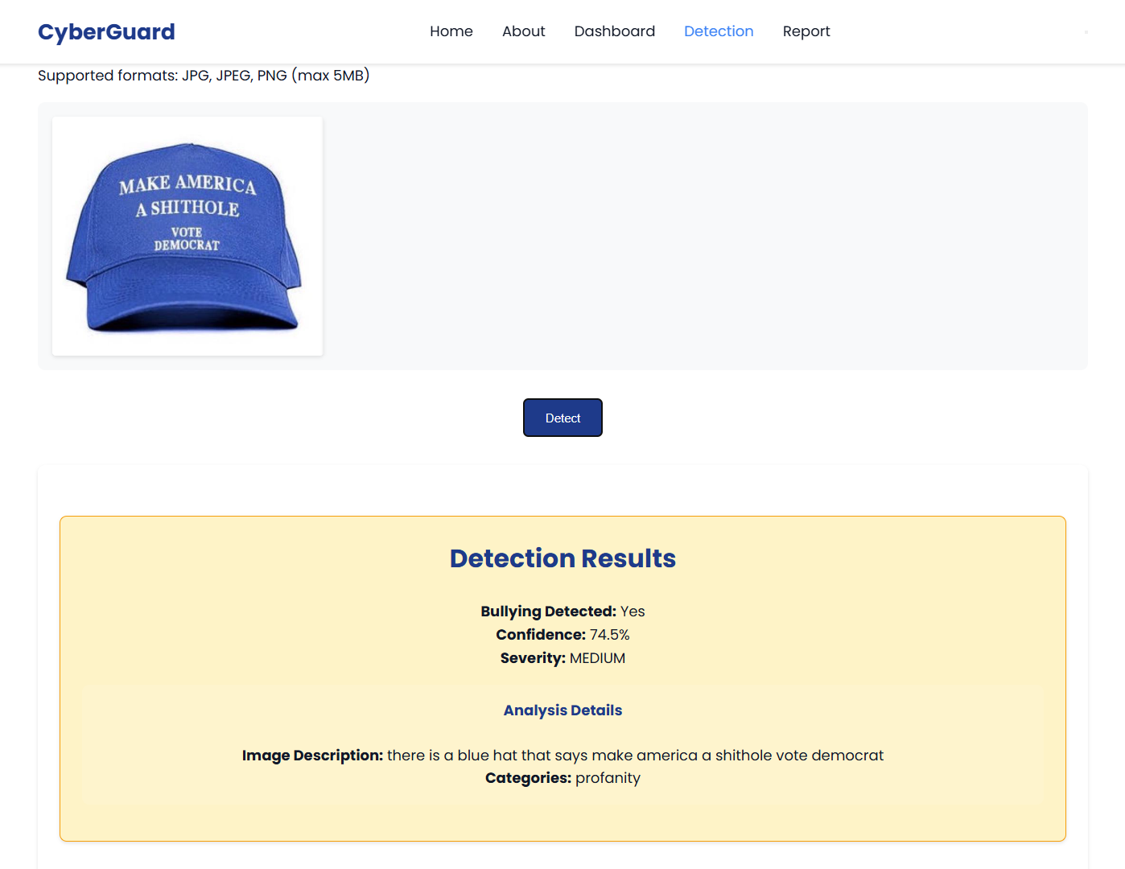
STRUCTURED OUTPUT
Structured Output
The system generates:
- bullying / not-bullying label
- confidence score
- severity level
- category of abuse
- BLIP image description
Example Result image 👉👉
Final_PPT
Department of CSE

Slide 21
INPUT ROUTING STRATEGY
Handling Different Input Types
Social media posts may contain:
- only text
- only image
- both text and image
The system dynamically selects the processing path.
Routing Mechanism
Text-only input → forwarded to BERT encoder
Image-only input → forwarded to BLIP encoder
Multimodal input →
- both encoders activated
- inter-modal attention applied
- fused representation generated
Benefit of Routing
Ensures flexibility for real-world scenarios
Works even when one modality is missing
Maintains consistent prediction pipeline
Final_PPT
Department of CSE

Slide 22
IMPLEMENTATION
Implementation:
Built on Google Colab (Python, PyTorch) using MMHS150K dataset.
Integrated BERT for text + BLIP for image encoding.
Model trained, validated, and saved as cyberbullying_model.pth.
Software Specs:
OS: Colab (Windows)
Frameworks: PyTorch, HuggingFace, Scikit-learn
Tools: Pandas, NumPy, Matplotlib,…..
Hardware Specs:
GPU: NVIDIA Tesla T4 (16 GB VRAM)
RAM: 13 GB | Storage: 100 GB (Google Drive)
Challenges & Solutions:
Data imbalance → Weighted loss & sampler
Noisy text and images → Text cleaning & image resizing
Overfitting → Early stopping & dropout
Slow training → GPU acceleration
Final_PPT
Department of CSE

Slide 23
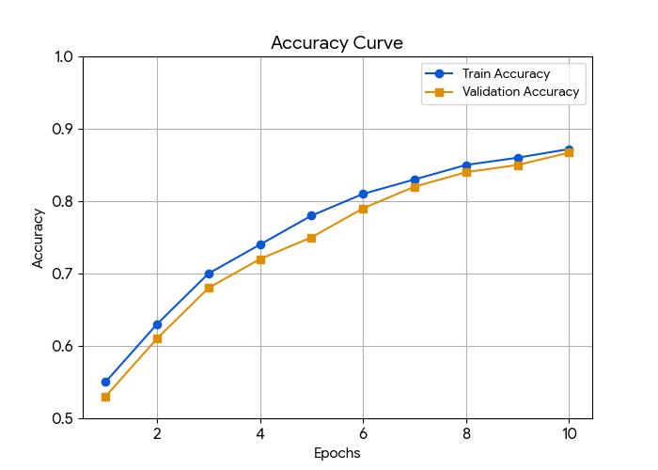
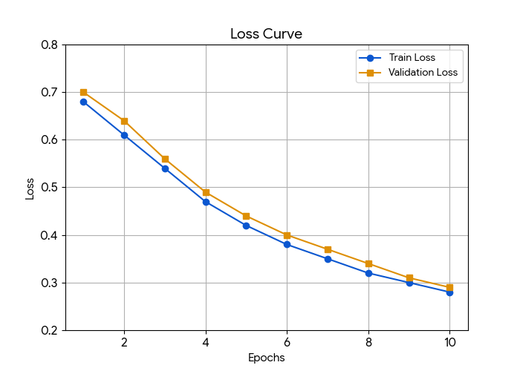
RESULTS & ANALYSIS
Training Progress
The Training & Validation Accuracy and Loss curves show how model performance improved over epochs.
Loss Curve: Gradual decrease → effective learning.
Accuracy Curve: Increased steadily → balanced accuracy.
Early stopping applied to prevent overfitting once validation loss is stabilized.
Final F1 score achieved around 0.852, ensuring both precision and recall stability.
Visual Insight:
Smooth convergence of loss curve shows good generalization.
Parallel rise in validation metrics indicates consistent learning.
Final_PPT
Department of CSE

Slide 24
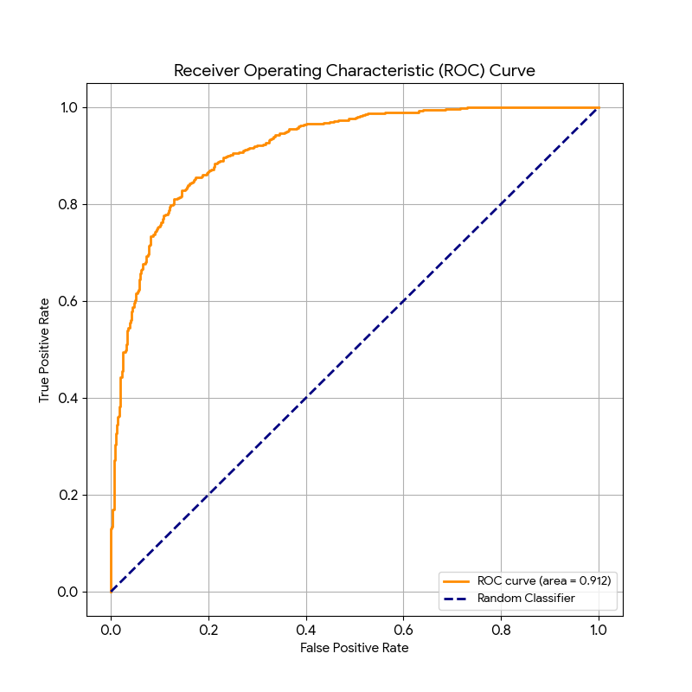
RESULTS & ANALYSIS
The ROC curve evaluates how well the model distinguishes between Bullying and Non-Bullying.
X-axis: False Positive Rate (FPR)
Y-axis: True Positive Rate (TPR)
The AUC (Area Under Curve) value close to 1.0 indicates strong model performance.
Our model achieved a high AUC (>0.912), showing excellent separation capability between classes.
Interpretation:
Curve near the top-left corner → better detection.
Indicates low false positives and high true detection of bots.
Final_PPT
Department of CSE

Slide 25
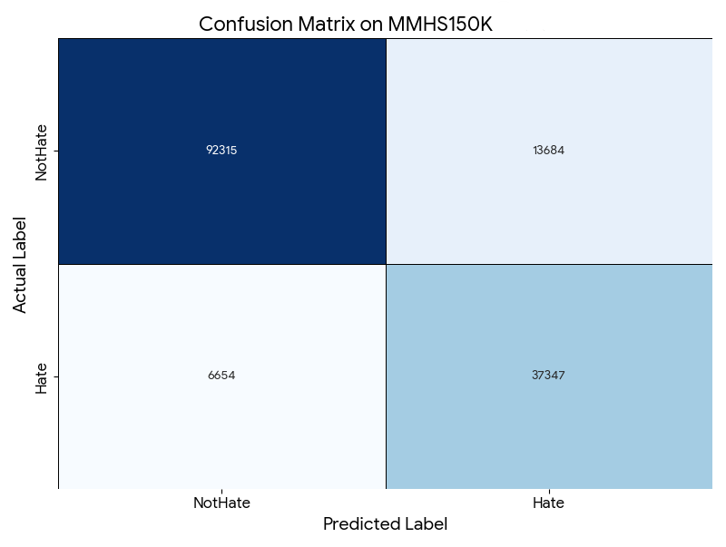
CONFUSION MATRIX
Performance Analysis
High number of True Positives and True Negatives
Low False Negative rate shows strong bullying detection
Balanced classification between both classes
Interpretation
Model correctly distinguishes harmful and non-harmful posts
Misclassifications are minimal and mostly ambiguous cases
Confirms robustness of inter-modal attention fusion
Significance
Demonstrates reliability for real-world deployment
Reduces risk of unfair content blocking
Maintains user safety with accurate moderation
Final_PPT
Department of CSE

Slide 26
STRENGHTS & CHALLENGES
Strengths
Multimodal Fusion – combines text and image semantics
Attention Alignment – learns relation between words and visuals
Works on Memes – handles sarcasm and implicit abuse
Scalable – adaptable for large social media platforms
Solutions
Weighted Loss to handle class imbalance
Text Cleaning to remove noise and slang
Image Resizing for uniform processing
Dropout to reduce overfitting
Challenges
Data Imbalance between bullying and non-bullying classes
Noisy Memes with complex or hidden meanings
High GPU Cost for multimodal training
Final_PPT
Department of CSE

Slide 27
APPLICATIONS
1. Social Media Content Moderation
Automatic detection of abusive posts before publishing
Real-time filtering of harmful comments and memes
Assists human moderators with priority-based alerts
Reduces manual workload on large platforms
2. Online Safety for Education
Monitoring student interactions in e-learning portals
Early identification of cyberbullying among teenagers
Protects mental health in school and college communities
Supports counselors with evidence-based reports
3. Community Management
Helps administrators manage forums and discussion groups
Flags toxic behavior in public chats and live streams
Encourages healthy digital communication culture
Prevents escalation of online conflicts
4. Platform Integration
Can be integrated with:
- Twitter/X moderation APIs
- Instagram comment filters
- YouTube live chat monitoring
Deployable as browser plugin or mobile service
Final_PPT
Department of CSE

Slide 28
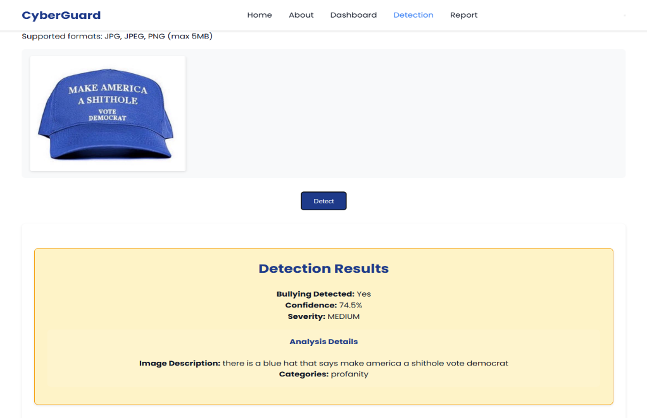
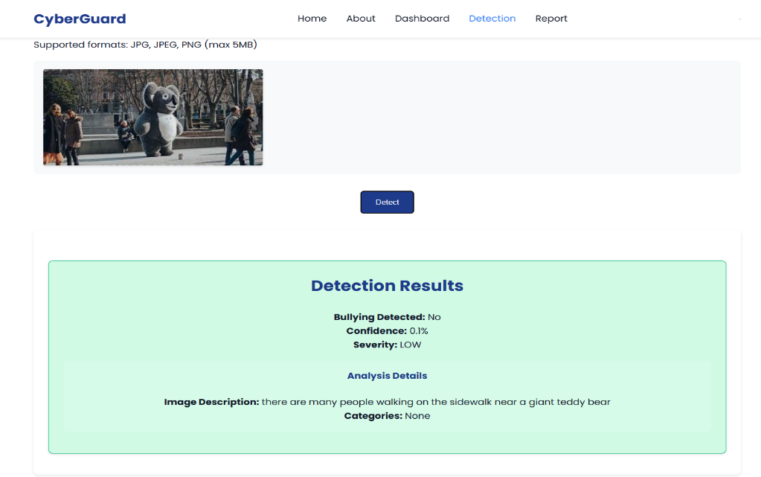
RESULTS & ANALYSIS
Bullying: YES/NO Classification Results
The classification visualization highlights the model’s predictions:
Orange/Red: Bullying detected.
Green: No Bullying detected.
The model learns to detect bullying by analyzing abusive or hateful language in text and harmful or offensive cues in images through inter-modal attention.
Bullying: Posts containing abusive language, hate speech, threats, or offensive images indicating harm or harassment.
Not Bullying: Posts with neutral, friendly, or informative text and non-offensive images showing no intent to harm.
Achieved 87.2% accuracy in Bullying or Not detection.
Final_PPT
Department of CSE

Slide 29
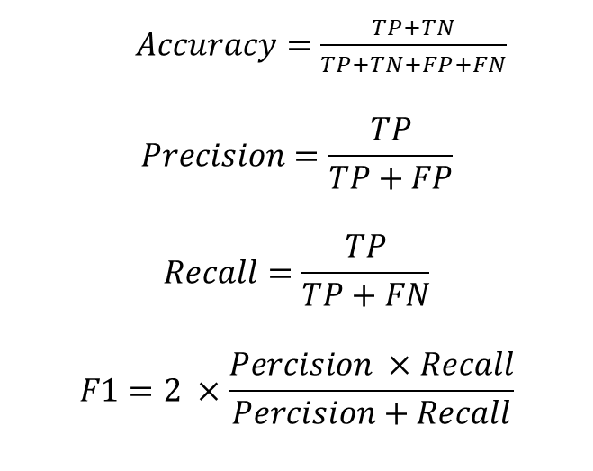
EVALUATION METRICS
Metrics Used
Accuracy – overall correctness of predictions
Precision – reliability of bullying predictions
Recall – ability to detect actual bullying cases
F1-Score – balance between precision and recall
AUC – discrimination capability of the model
Purpose
Ensures fair comparison with baseline models
Measures robustness across different inputs
Evaluates real-world applicability
$Accuracy=\frac{TP+TN}{TP+TN+FP+FN}$
$$Precision=\frac{TP}{TP+FP}$$
$$Recall=\frac{TP}{TP+FN}$$
$$F1=2 ×\frac{Percision ×Recall}{Percision+Recall}$$
Final_PPT
Department of CSE

Slide 30
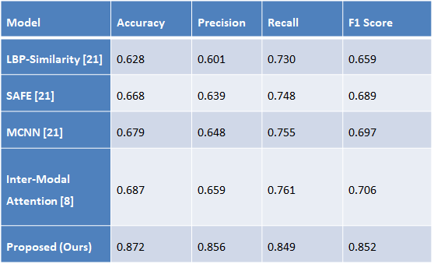
BASELINE MODELS FOR COMPARISON
LBP-Similarity – handcrafted visual features
SAFE – sentiment-aware multimodal CNN
MCNN – parallel text and image CNN
Existing Inter-Modal Attention model
Goal of Comparison
Validate improvement over prior methods
Demonstrate effectiveness of proposed fusion
Show generalization on MMHS150K dataset
Final_PPT
Department of CSE

Slide 31
MODEL PERFORMANCE SUMMARY
Final Test Results
Accuracy: 87.2%
Precision: 85.6%
Recall: 84.9%
F1-Score: 85.2%
AUC: 0.912
Key Observations
Balanced performance across all metrics
High precision shows low false alarms
Strong recall indicates effective bullying detection
AUC confirms good class separability
Outcome
Proposed model outperforms existing baselines
Suitable for real-world social media moderation
Demonstrates reliable multimodal understanding
Final_PPT
Department of CSE

Slide 32
LIMITATIONS
Language Constraint
Model is trained mainly on English datasets
Limited performance on multilingual or code-mixed content
Requires adaptation for regional languages
Modality Restriction
Currently supports text and images only
Cannot process video or audio based bullying cues
Temporal context from reels or live streams is not considered
Resource Requirement
Training requires high-end GPU
Large memory needed for BERT and BLIP models
Deployment on low-power devices is challenging
Final_PPT
Department of CSE

Slide 33
CONCLUSION and FUTURE SCOPE
Key Findings
Achieved 87.2% accuracy and F1-score of 0.852 on MMHS150K dataset.
BERT + BLIP + inter-modal attention model outperformed single-branch models (text-only).
The model learned semantic meaning from BERT text embeddings, visual context from BLIP image encoder, and used inter-modal attention to align and fuse these features—capturing relationships between words and visuals for accurate cyberbullying detection.
Demonstrated strong generalization with AUC > 0.912 and low false detection rate.
Significance of Results
These results highlight the model’s suitability for real-world social media moderation systems.
It enhances context understanding, improves classification performance, and provides a foundation for developing real-time, and explainable online safety systems.
The proposed framework is highly adaptable, allowing integration with various social media platforms and making it suitable for diverse online environments.
Final_PPT
Department of CSE

Slide 34
CONCLUSION and FUTURE SCOPE
Future Developments
Several directions can further enhance the model’s effectiveness:
Multilingual Handling: Adoption of models such as XLM-RoBERTa for improved support of code-mixed and regional content.
Deployment Optimization: Application of pruning or quantization for faster inference in real-time moderation systems.
Robustness: Enhancement of resistance to adversarial inputs such as obfuscated text or modified images.
Limitations
Currently trained on English data, limiting performance on multilingual or code-mixed content.
The framework currently processes only text and images, excluding videos or audio cues that may indicate bullying behavior.
Final_PPT
Department of CSE

Slide 35
CONTRIBUTIONS
Novel Fusion Mechanism
Introduced inter-modal attention for aligning text and image
Effective combination of BERT and BLIP representations
Improved contextual understanding over traditional methods
Enhanced Output Design
Generates severity level along with classification
Provides structured metadata for moderation
Supports category-wise identification of bullying types
Practical Deployment
Model designed as deployable API service
Suitable for real-time social media monitoring
Easily integrable with existing moderation platforms
Final_PPT
Department of CSE

Slide 36
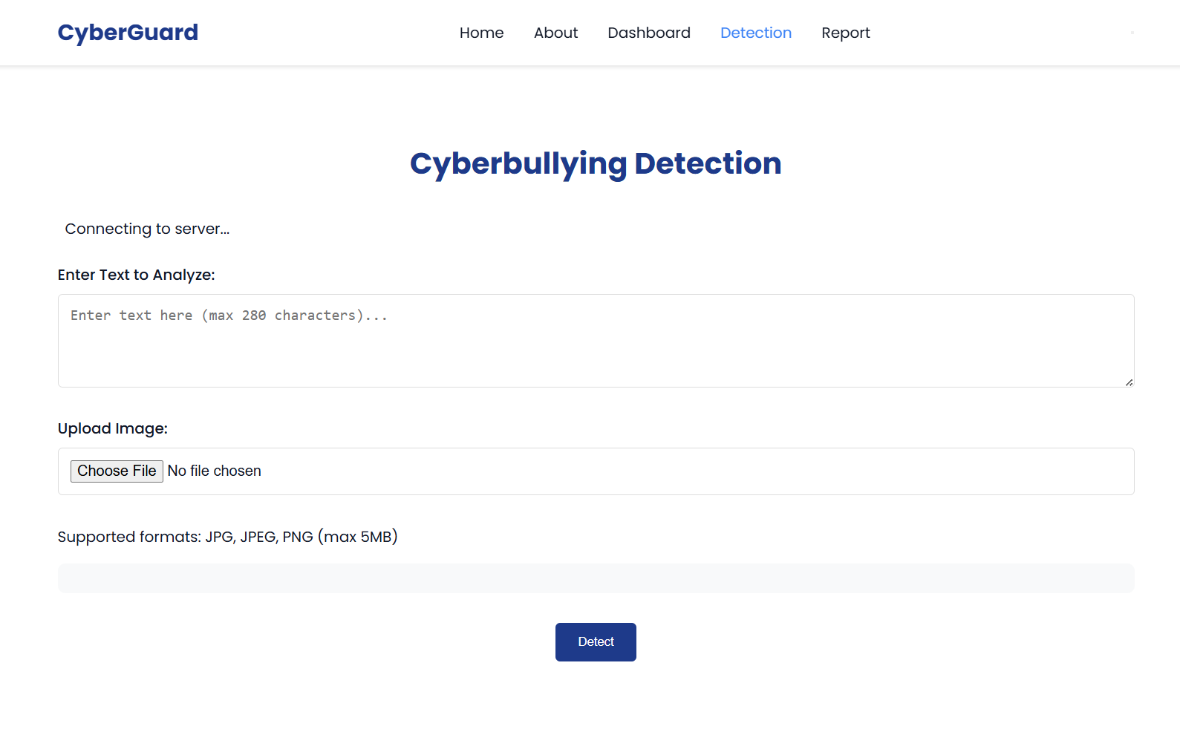
OUTPUT SCREENS
Final_PPT
Department of CSE

Slide 37
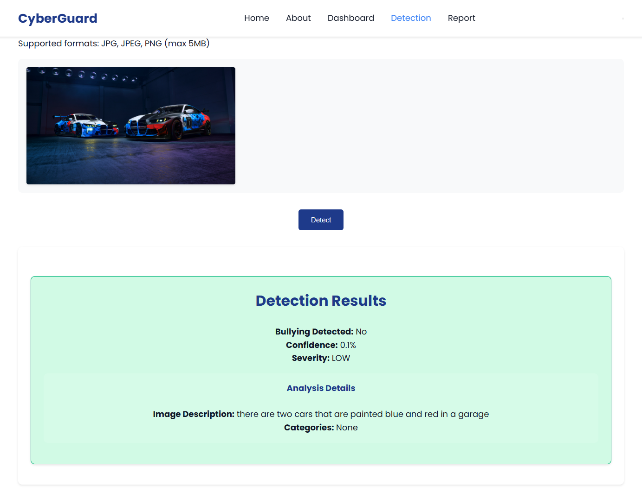
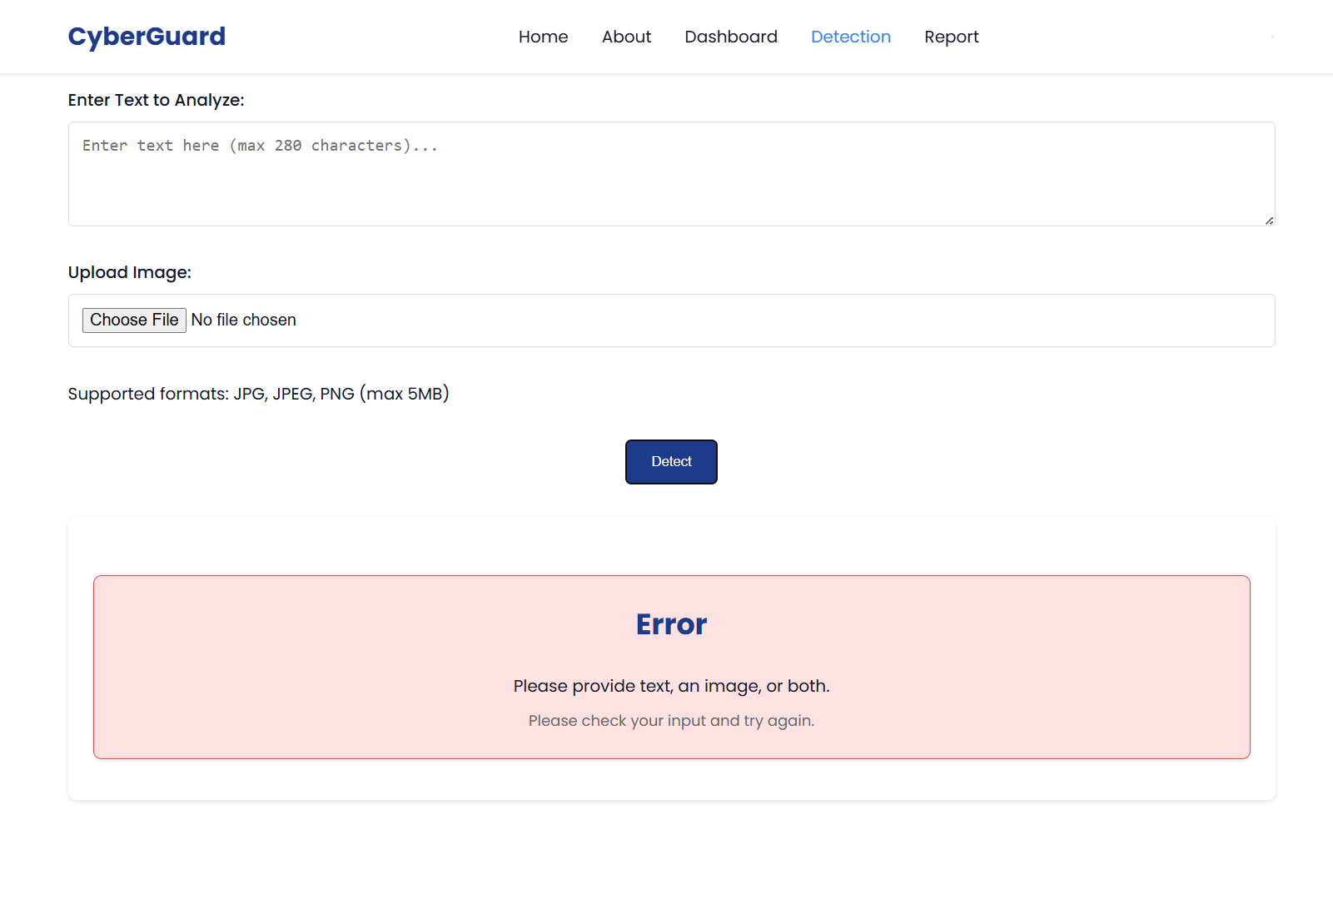
OUTPUT SCREENS
Final_PPT
Department of CSE

Slide 38
REFERENCES
[1] UNICEF (2019): Reported that over one-third of young people across 30 countries experience online bullying, emphasizing the global scale of the issue.
[2] Gillespie (2018): Discussed how content moderation shapes online discourse, revealing the complex role of platforms in managing harmful content.
[3] Meta Platforms Inc. (2023): Outlined Meta’s policies and community standards for moderating online abuse and enforcing safe digital spaces.
[4] Joachims (1998): Introduced Support Vector Machines for text categorization, forming a foundational approach for modern text-based classification.
[5] Shaik Rafi et al. (2025): Developed a sarcasm detection system across headlines and text, contributing to better sentiment and intent understanding.
[6] Devlin et al. (2019): Proposed BERT, a bidirectional transformer model that revolutionized contextual text representation for NLP tasks.
[7] Ayetiran & Ozgobek (2024): Presented an inter-modal attention framework integrating text and image modalities for multimodal content analysis.
Final_PPT
Department of CSE

Slide 39
REFERENCES
[8] Reddy et al. (2025): Implemented CNN-based deep learning for automated traffic sign recognition, demonstrating efficient visual feature extraction.
[9] Al-Khasawneh et al. (2024): Proposed a multimodal approach for detecting cyberbullying using combined textual and visual cues from social networks.
[10] Al-Hashedi & Maheshwari (2023): Designed an emotion-based cyberbullying detection model leveraging affective features from textual content.
[11] Ravuri Daniel (2023): Utilized ensemble learning with optimization algorithms to improve cyberbullying detection accuracy on social media.
[12] Razi & Ejaz (2024): Developed a multilingual cyberbullying detection system handling Urdu, Roman Urdu, and English social media posts.
[13] Jamjoom & Majeed (2024): Enhanced RoBERTa with GloVe features to improve transformer-based cyberbullying detection performance.
[14] Daraghmi & Basulaiman (2024): Proposed a CNN-BiLSTM-GRU hybrid model for effective Arabic cyberbullying detection from text data.
[15] Naqvi & Atif (2024): Focused on detecting cyberbullying and profiling abusers in Roman Urdu social media interactions.
Final_PPT
Department of CSE

Slide 40
REFERENCES
[16] Ibrahim & Ben Ali (2024): Introduced a neural network-based hate speech detection framework incorporating uncertainty modeling for robustness.
[17] Gomez et al. (2020): Created a benchmark dataset and baseline models for multimodal hate speech detection combining text and images.
[18] Alfurayj & Shah (2024): Proposed a chained deep learning model capturing bystander dynamics for fine-grained cyberbullying detection.
[19] Moturi et al. (2024): Applied CNNs on gammatonegram features for detecting abnormalities in PCG signals, showcasing signal analysis via deep learning.
[20] Venkatareddy et al. (2024): Presented deep learning-based innovations in communication and computing technologies for modern applications.
[21] Greeshma et al. (2022): Discussed deep learning advances in network systems, offering insights into neural model integration across domains.
[22] Jagannadham et al. (2021): Explored IoT and cloud-driven architectures, focusing on scalable, intelligent computing solutions.
[23] Ayetiran & Ozgobek (2024): Developed an inter-modal attention-based deep learning framework using unified modality for multimodal cyberbullying detection.
Final_PPT
Department of CSE

Slide 41
ACKNOWLEGEMENTS
Thank You!
We sincerely thank the Co-ordintor’s, faculty, and audience for giving us the opportunity to present our project — “MULTIMODAL CYBERBULLYING DETECTION USING
INTER-MODAL-ATTENTION-BASED DEEP LEARNING”
Your attention, feedback, and questions are truly appreciated. For any further discussions or collaboration inquiries, feel free to contact us:
Contact Information
Tatapudi Rajesh – rajeshtatapudi1819@gmail.com
Mothe Suneetha – msuneetha973@gmail.com
Panchumarthi Lakshmi Gopinath – gsgopinath3@gmail.com
Chilaka Santhosh– chilakasanthosh11@gmail.com
Final_PPT
Department of CSE

Slide 42
QUESTIONS and ANSWERS
Thank You! From DB7
We appreciate your attention and interest. Now, we’d like to open the floor for questions and discussions.
💬 Feel free to ask about the model, dataset, or future work!
Final_PPT
Department of CSE

